Slide 1

Name: __________________________________
August 2022 © by PIKAS (pikas.dzlm.de)

Slide 2
Name: __________________________________
August 2022 © by PIKAS (pikas.dzlm.de)

Slide 3


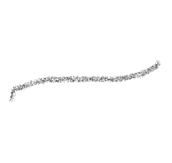
1 |  |  |  |  |  |  |  |  | 10
1
August 2022© by PIKAS (pikas.dzlm.de)

Slide 4

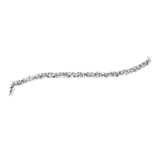
1 |  |  |  |  |  |  |  |  | 10
1
August 2022© by PIKAS (pikas.dzlm.de)

Slide 5

1 | 2 |  |  | 5 |  | 7 |  |  | 10
2
August 2022 © by PIKAS (pikas.dzlm.de)

Slide 6
1 | 2 |  |  | 5 |  | 7 |  |  | 10
2
August 2022 © by PIKAS (pikas.dzlm.de)

Slide 7

 | 12 |  | 14 |  |  |  |  | 19
3
August 2022 © by PIKAS (pikas.dzlm.de)

Slide 8
 | 12 |  | 14 |  |  |  |  | 19
3
August 2022 © by PIKAS (pikas.dzlm.de)

Slide 9

4 | 5 | 6
 | 2
 | 17
 | 11
 | 9
4
August 2022 © by PIKAS (pikas.dzlm.de)

Slide 10
4 | 5 | 6
 | 2
 | 17
 | 11
 | 9
4
August 2022 © by PIKAS (pikas.dzlm.de)

Slide 11

7
12
2
16
10
5
August 2022 © by PIKAS (pikas.dzlm.de)

Slide 12
7
12
2
16
10
5
August 2022 © by PIKAS (pikas.dzlm.de)

Slide 13

4
9
3
6
August 2022 © by PIKAS (pikas.dzlm.de)

Slide 14
4
9
3
6
August 2022 © by PIKAS (pikas.dzlm.de)

Slide 15

 | 17
 | 11
 | 8
7
August 2022 © by PIKAS (pikas.dzlm.de)

Slide 16
 | 17
 | 11
 | 8
7
August 2022 © by PIKAS (pikas.dzlm.de)

