Slide 1


Name: __________________________________
August 2021 © by PIKAS (pikas.dzlm.de)

Slide 2
Name: __________________________________
August 2021 © by PIKAS (pikas.dzlm.de)

Slide 3



2
10
4
8
3
5
11
13
20
15
17
1
August 2021 © by PIKAS (pikas.dzlm.de)

Slide 4
2
10
4
8
3
5
11
13
20
15
17
1
August 2021 © by PIKAS (pikas.dzlm.de)

Slide 5






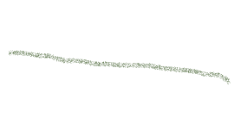
2
August 2021 © by PIKAS (pikas.dzlm.de)

Slide 6
2
August 2021 © by PIKAS (pikas.dzlm.de)

Slide 7



3
August 2021 © by PIKAS (pikas.dzlm.de)

Slide 8
3
August 2021 © by PIKAS (pikas.dzlm.de)

Slide 9




*
4
August 2021 © by PIKAS (pikas.dzlm.de)

Slide 10
*
4
August 2021 © by PIKAS (pikas.dzlm.de)

Slide 11












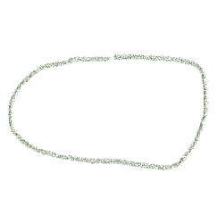
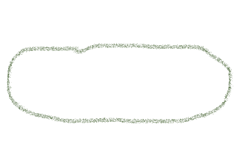
5
August 2021 © by PIKAS (pikas.dzlm.de)

Slide 12
5
August 2021 © by PIKAS (pikas.dzlm.de)

Slide 13

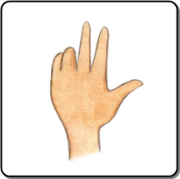


6
August 2021 © by PIKAS (pikas.dzlm.de)

Slide 14
6
August 2021 © by PIKAS (pikas.dzlm.de)

Slide 15

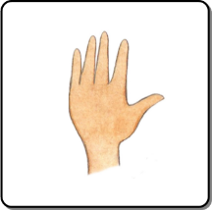




7
August 2021 © by PIKAS (pikas.dzlm.de)

Slide 16
7
August 2021 © by PIKAS (pikas.dzlm.de)

Slide 17


8
August 2021 © by PIKAS (pikas.dzlm.de)

Slide 18
8
August 2021 © by PIKAS (pikas.dzlm.de)

Slide 19

6 + 2
9
August 2021 © by PIKAS (pikas.dzlm.de)

Slide 20
6 + 2
9
August 2021 © by PIKAS (pikas.dzlm.de)

Slide 21


10
August 2021 © by PIKAS (pikas.dzlm.de)

Slide 22
10
August 2021 © by PIKAS (pikas.dzlm.de)

Slide 23

8 - 3
11
August 2021 © by PIKAS (pikas.dzlm.de)

Slide 24
8 - 3
11
August 2021 © by PIKAS (pikas.dzlm.de)

Slide 25



3
8
12
August 2021 © by PIKAS (pikas.dzlm.de)

Slide 26
3
8
12
August 2021 © by PIKAS (pikas.dzlm.de)

Slide 27


13
August 2021 © by PIKAS (pikas.dzlm.de)

Slide 28
13
August 2021 © by PIKAS (pikas.dzlm.de)

Slide 29

3 €
14
August 2021 © by PIKAS (pikas.dzlm.de)

Slide 30
3 €
14
August 2021 © by PIKAS (pikas.dzlm.de)

Slide 31
 |  |  |  |  |  |  |  |  |  |  | x
 |  |  |  |  |  |  |  |  |  |  | x
 |  |  |  |  |  |  |  |  |  |  | x
15
August 2021 © by PIKAS (pikas.dzlm.de)

Slide 32
 |  |  |  |  |  |  |  |  |  |  | x
 |  |  |  |  |  |  |  |  |  |  | x
 |  |  |  |  |  |  |  |  |  |  | x
15
August 2021 © by PIKAS (pikas.dzlm.de)

